Slide 1
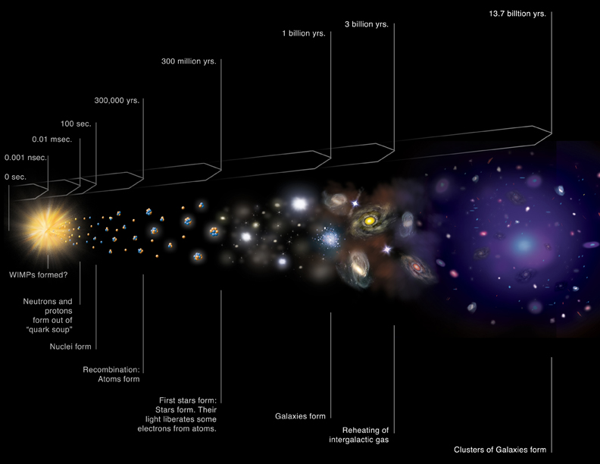
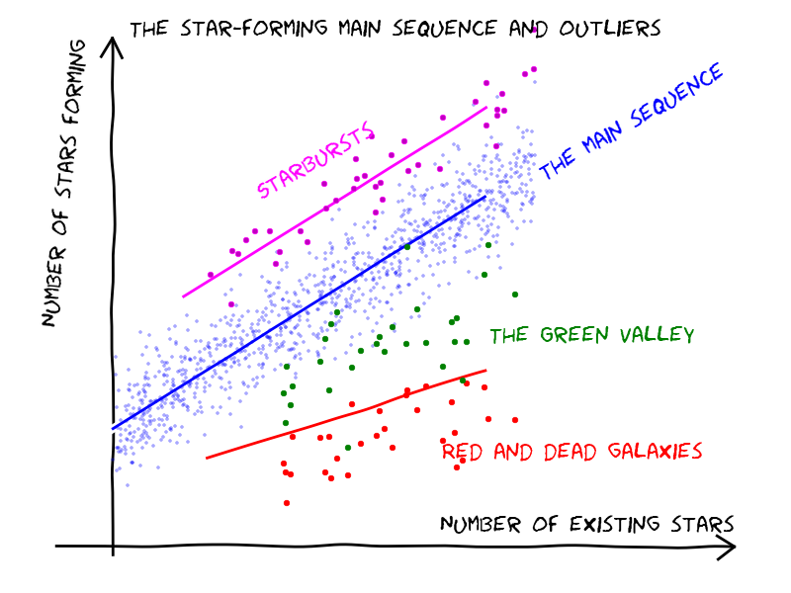
Galaxy formation (intro)
Main idea: this is a well-known time slice of the Universe. We know that stars appeared earlier than galaxies. Stellar population is different in different galaxies and it evolves in time. This makes different galaxies look different and early-type galaxies don't look like late-type galaxies that we see in the local Universe. In order to study it we need to study the evolution of the stellar popultation over cosmic time.

Slide 2
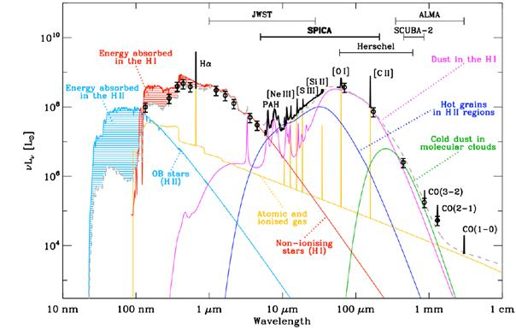
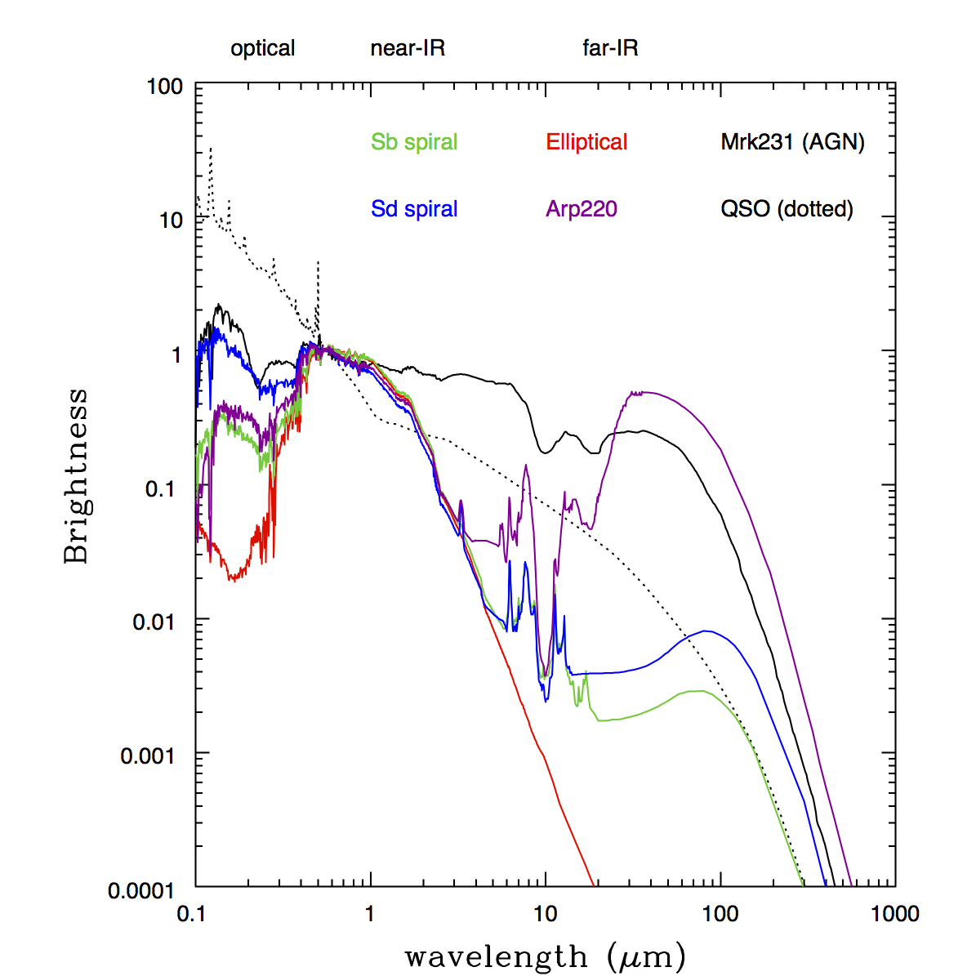
Why galaxies are different
Different components of a galaxy invest specific part of the flux in different parts of EM spectra. We can find out what the galaxy «is made of» by looking at its spectrum.
Different telescopes work in different bands and to find mass content of a galaxy we need to trace cool low mass stars that brings most of the stellar mass of the galaxy.

Slide 3
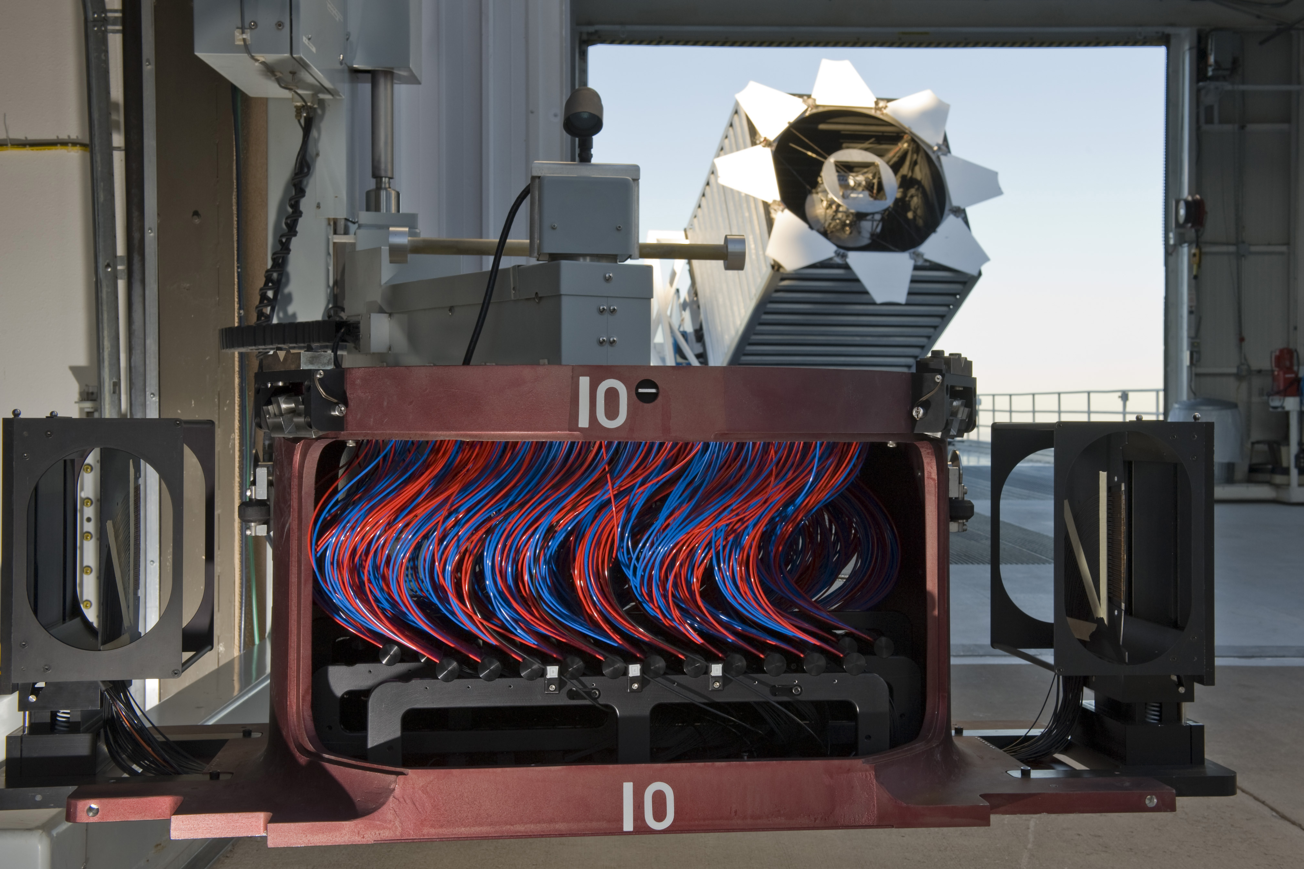
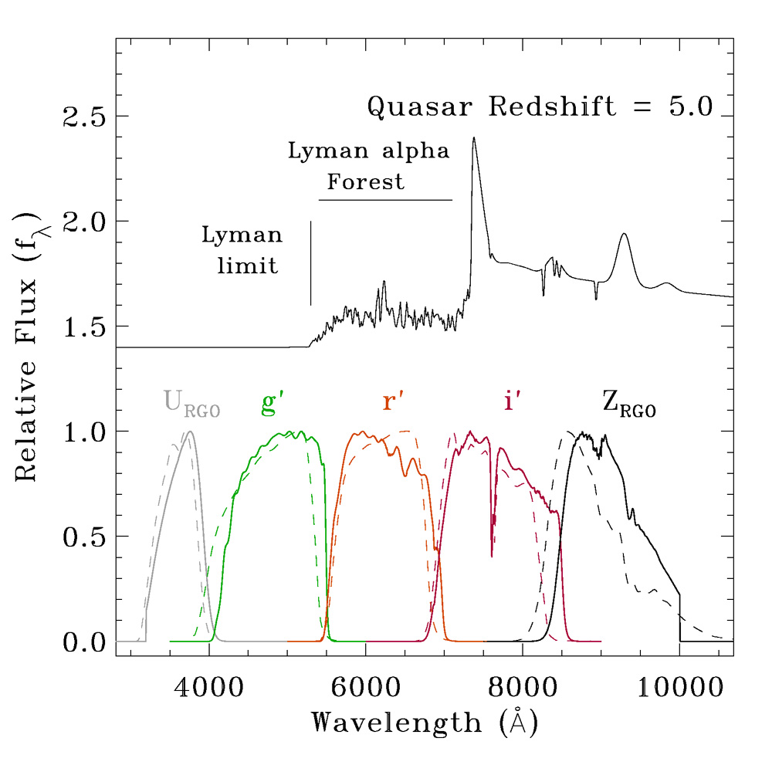
Telescopes for work: SDSS
SDSS, it's main charcteristics (scans sky, fibers, 5 optical bands, relative small size). Mostly useful for «normal» galaxies up to z<0.4 but using different techniques (like dropouts) can detect high z galaxies (but needs confirmation from other telescopes).

Slide 4
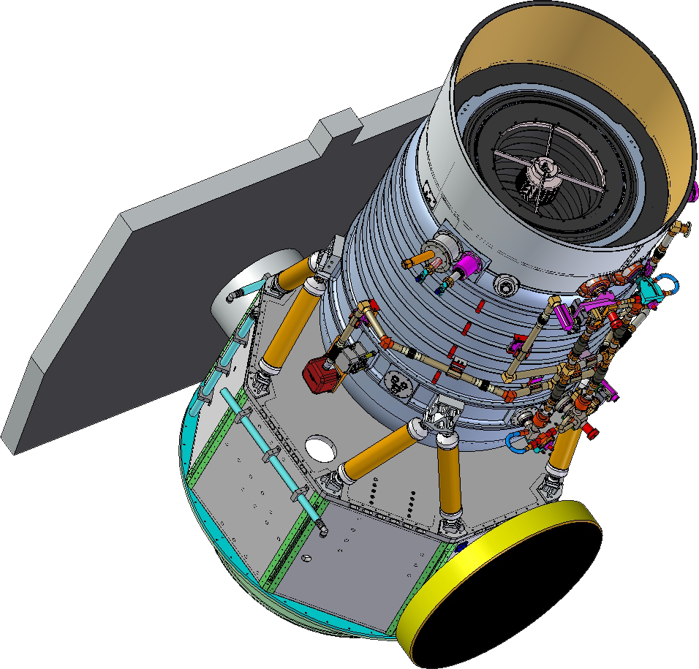
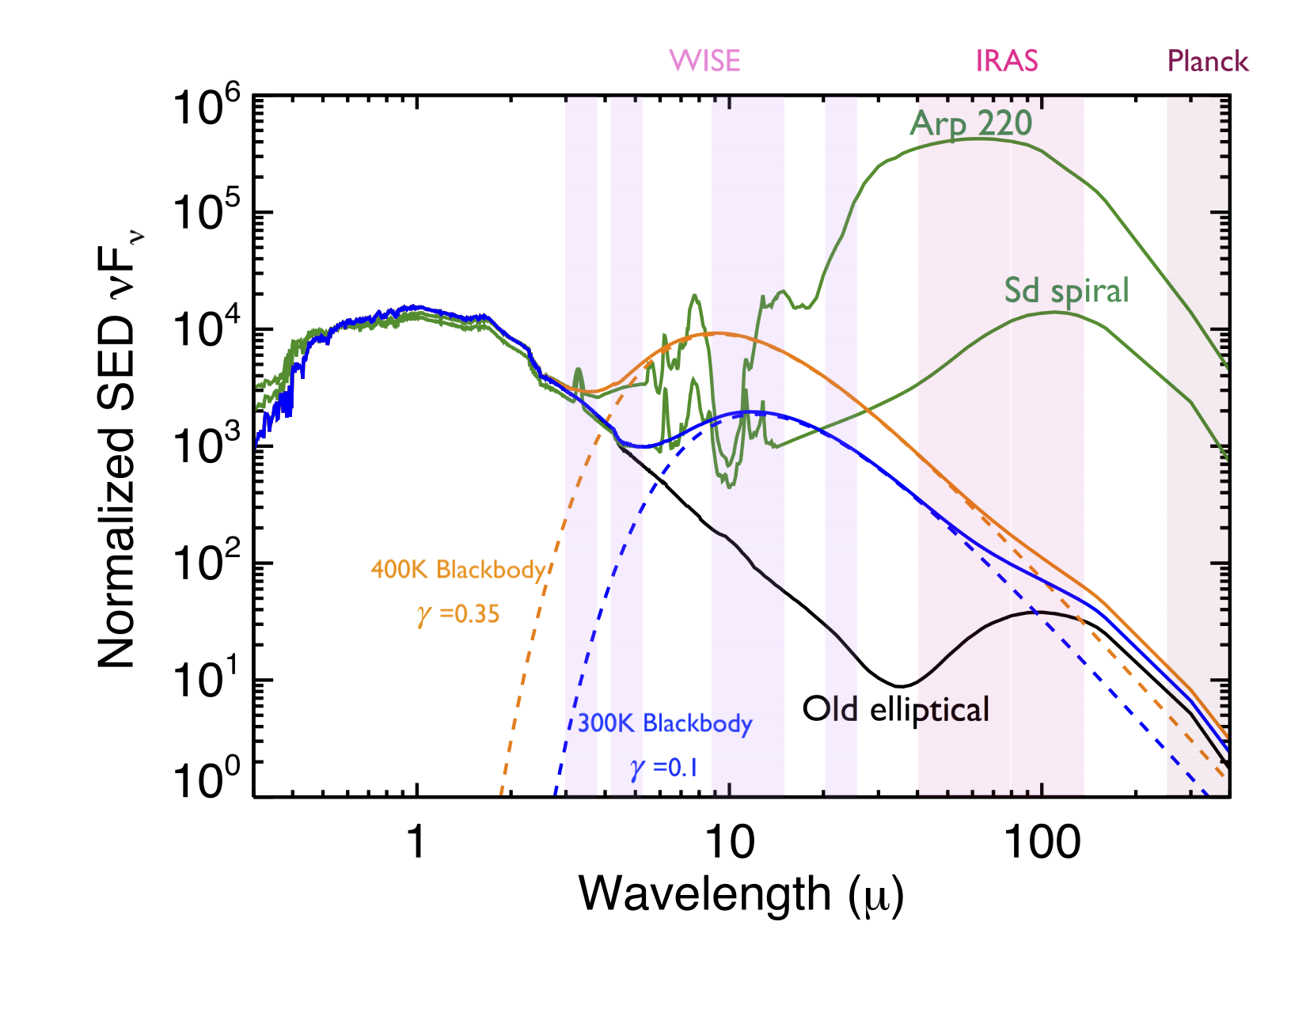
Telescopes for work: WISE
WISE, all-sky near-IR telescope with 4 bands with different sensitivity (third band is significantly larger and in turms of PSF and limiting flux is closer to w1 and w2). Telescope is used for detection and observations of intrinsically red objects — dusty galaxies, old galaxies, brown dwarfs, galaxies at high redshifts.

Slide 5
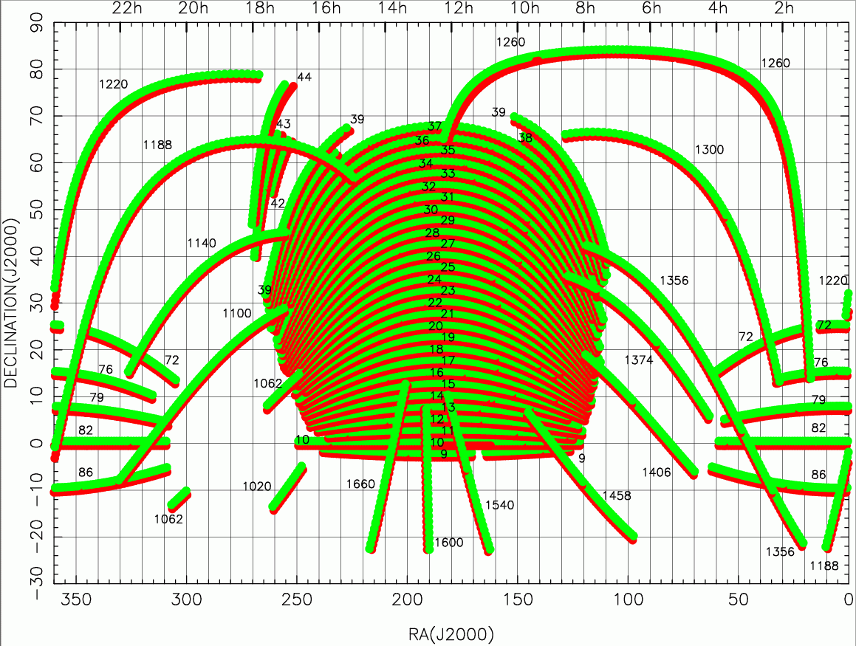
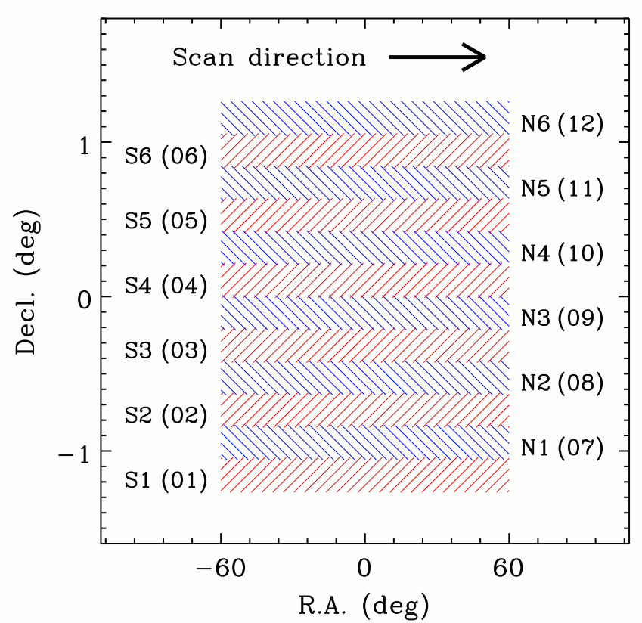
Our field - Stripe 82
Stripe 82 (can be seen in the middle-right part) is a region of the sky close to selectial aquator that was repetedly scanned by SDSS for 70-90 times (comparing to single pass for the most of the rest of areas). 12 stripes with different psf, usually worse closer to the edges.

Slide 6
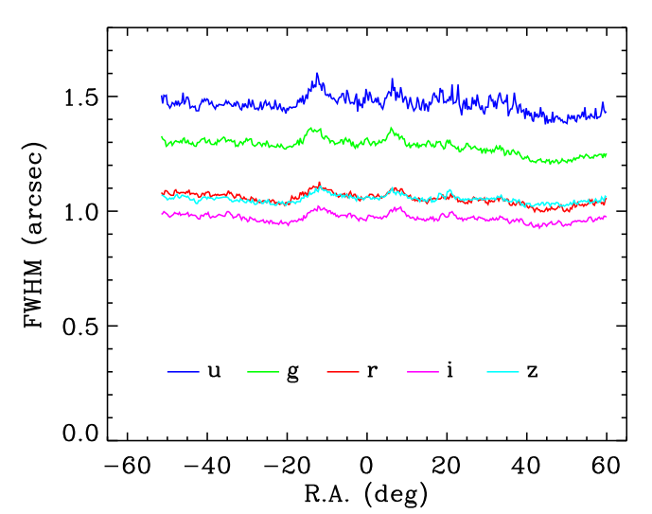
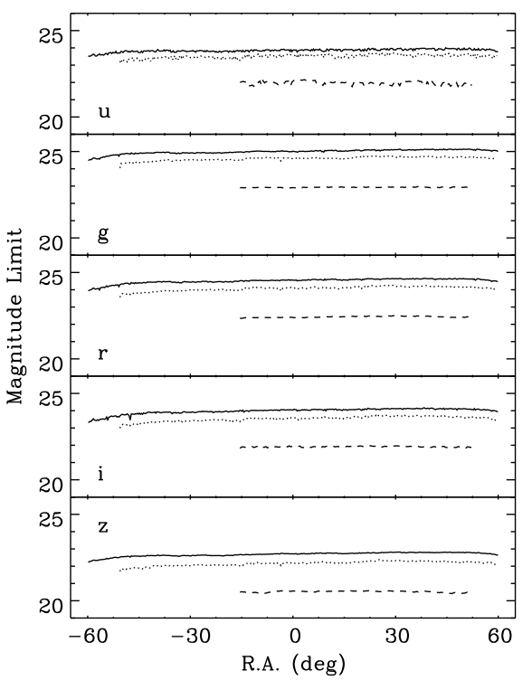
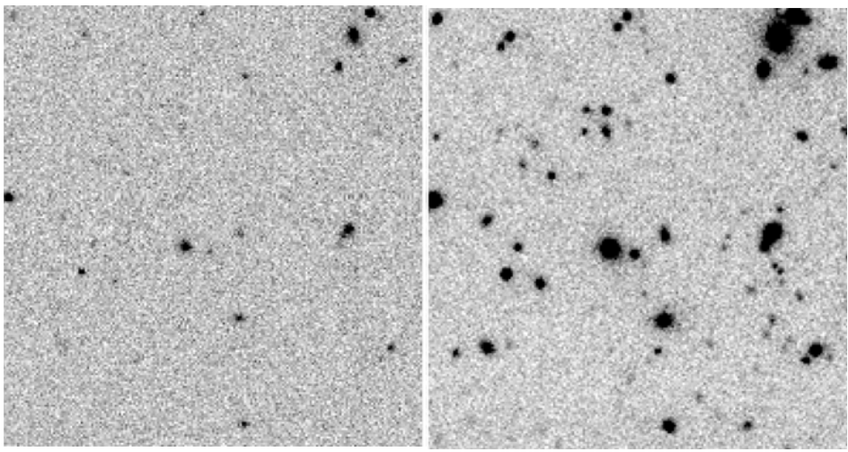
SDSS co-adds
Jiang's co-added images increased limiting mag to 1-2 mag deeper than single pass images. He took only images with the best seeing so his FWHM is also very increased. Those images explain our choice of i-band as a high-resolution image for the next steps.

Slide 7
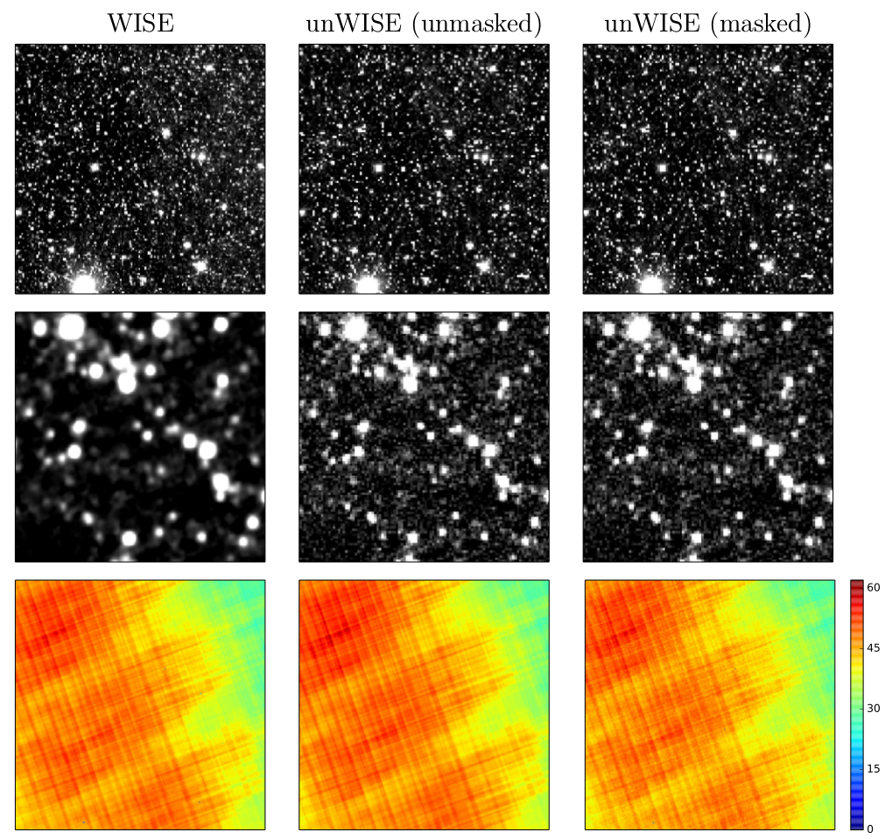
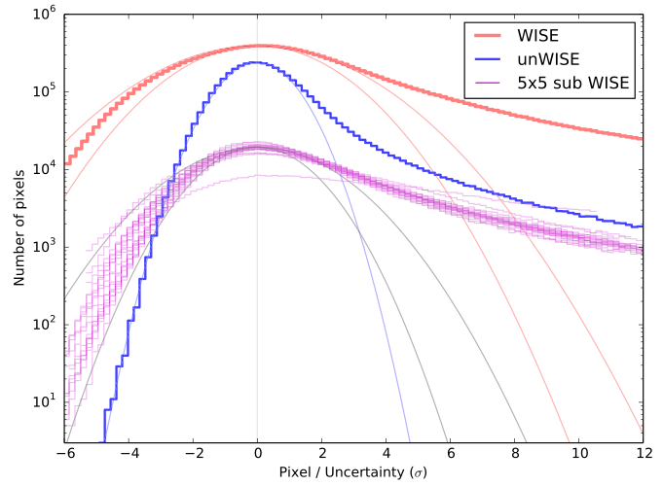
Not WISE - unWISE
Lang's co-adds with restored WISE pixel scale (2.75 instead of 1.375). This has led to the decrease in the sky variance and unWISE ratio of pixel/per-pixel uncertainty is now close to the unit Gaussian (plus source tail from real sources)

Slide 8
Our work starts here
To do «template fitting» we need to change pixel scale of high-res images and change the reference pixel value so that SDSS and WISE images of so different sizes are totally alligned.
(I will put here SDSS image on top of the WISE image to compare sizes)

Slide 9
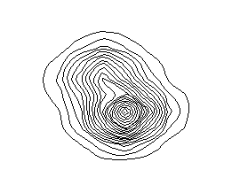
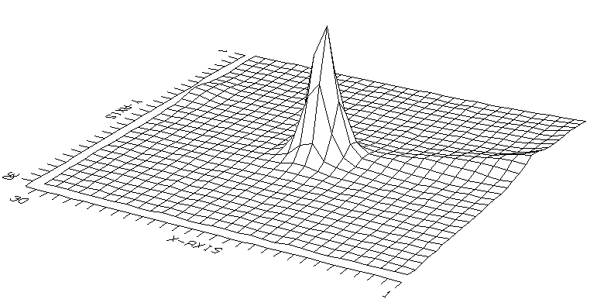
We performed our own photometry
Jiang's catalogs on co-adds miss a certain number of sources that we would like to use in our work, so we constructed our own catalog with the folowing parameters:
in total we obtained more than 22 million sources.
I will show here one of SDSS image with region files for detected sources, PSF selection criteria and couple of bad, non point-like sources.

Slide 10

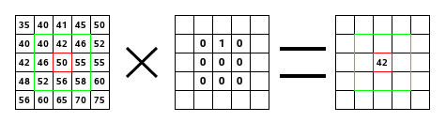
PSF kernel
In order to do «template fitting» we need to construct the kernel K such that PSF_lores = K * PSF_hires
On this slide I will show 2 different PSFs and a resulting kernel

Slide 11
Residual images
I am showing here residual images from Tphot — one as a full WISE image with small part being «cleaned» and second one — zoomed in cutout

Slide 12
Residual images (zoomed in)

Slide 13
Colors and magnitudes of our sample
Here I present i-w1 vs i-w2 and mag_auto vs magerr_auto of the catalog produced by tphot to show colors and limiting magnitude of our sample

Slide 14
SED
On this slide there there will be 1 constructed SED with Jiang's data for u,g,r,i,z and our data for i, w1,w2 and matched spectra, also parameters of this galaxy will be shown

Slide 15
Mass and redshift histogram from HyperZ
If I have time to run Hyperz several times I will show mass histograam and redshift histogram for a small region of Stripe 82 an mention that those sources will be matched with origianl catalog to correct for magnitudes and gind potential spectroscopic redshifts.

Slide 16
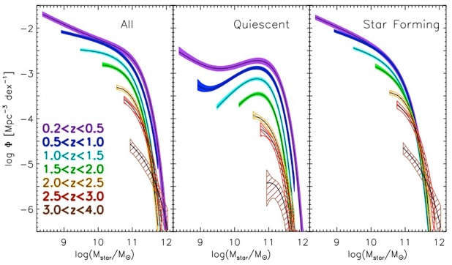
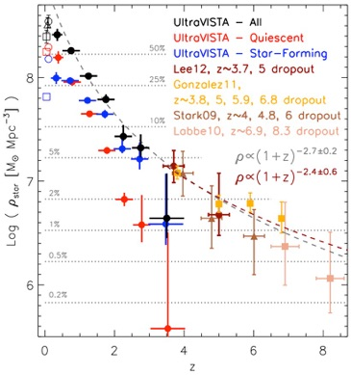
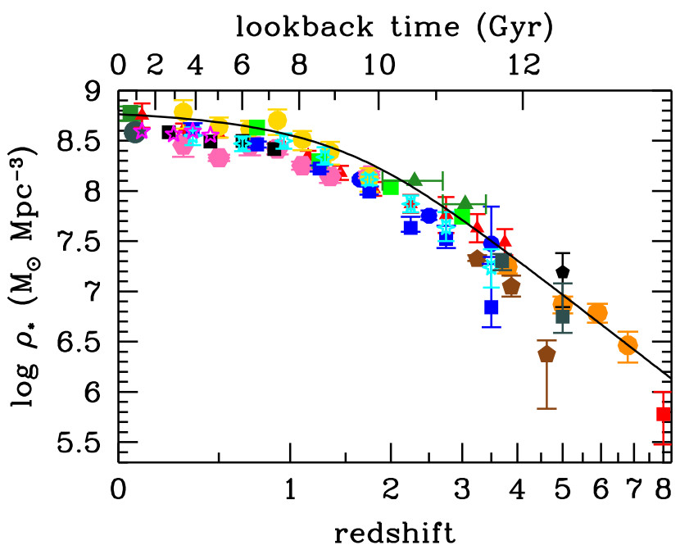
Mass Function, GSMD
Mass functions from literature, Press-Shechter formalism. Upper-right image — from Muzzin for Ultravista, for high-z galaxies. Bottom image — From Madau & Dickinson, 2014.

Slide 17
Dropouts. images
Tphot residuals with bright sources in w1 and w2 and no detection in SDSS

Slide 18
Dropouts. SED
I will show matched spectra for the dropout sources for which I run hyperz and the plot of the oldest possible dropout galaxies that I showed you on the droup meeting.

Slide 19
Conclusions, Future work.

